Slide 1

Gradient Descent and Regression
Dr. Linrui Zhang
University of Central Missouri

Slide 2
Outline
Gradient Descent
Linear Regression
Logistic Regression

Slide 3
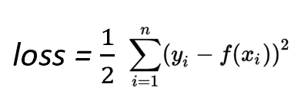
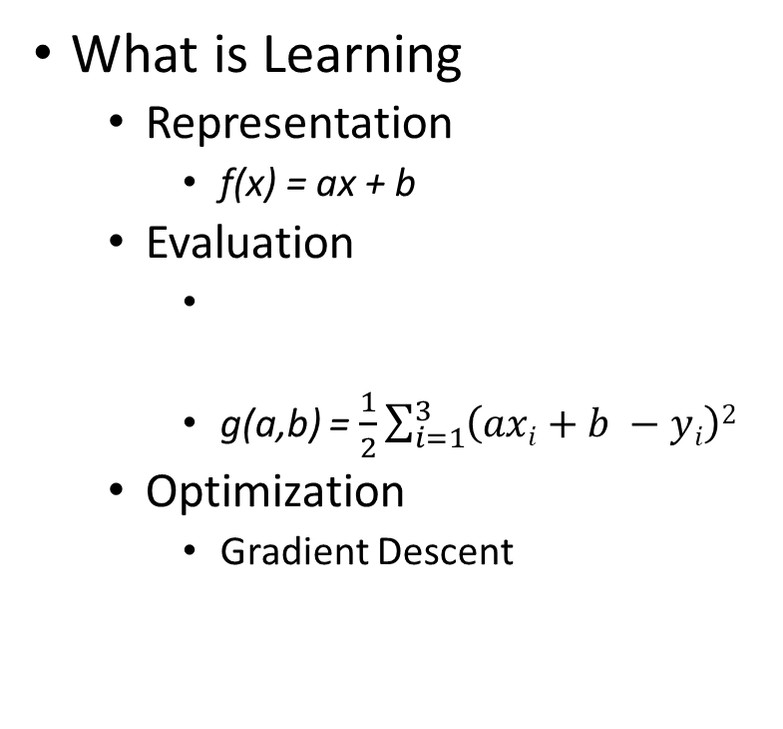
Learning
f(x)
C(2.9,3.2)
3
2
B(2.3,1.9)
What is Learning
Representation
f(x) = ax + b
Evaluation
g(a,b) = $\frac{1}{2}\sum_{i=1}^{3}{\left(axi+b −yi\right)2}$
Optimization
Gradient Descent
A(0.5,1.4)
1
0
1
2
3
x

Slide 4
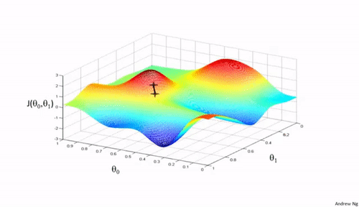
Gradient Descent
In mathematics gradient descent is a first-order iterative optimization algorithm for finding a local minimum of a differentiable function.
3D
2D

Slide 5
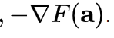
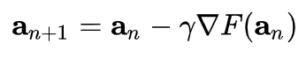
Gradient Descent
Gradient descent is based on the observation that if the multi-variable function F(x) is defined and differentiable in a neighborhood of a point a, then F(x) decreases fastest if one goes from a in the direction of the negative Gradient of F at a,

Slide 6
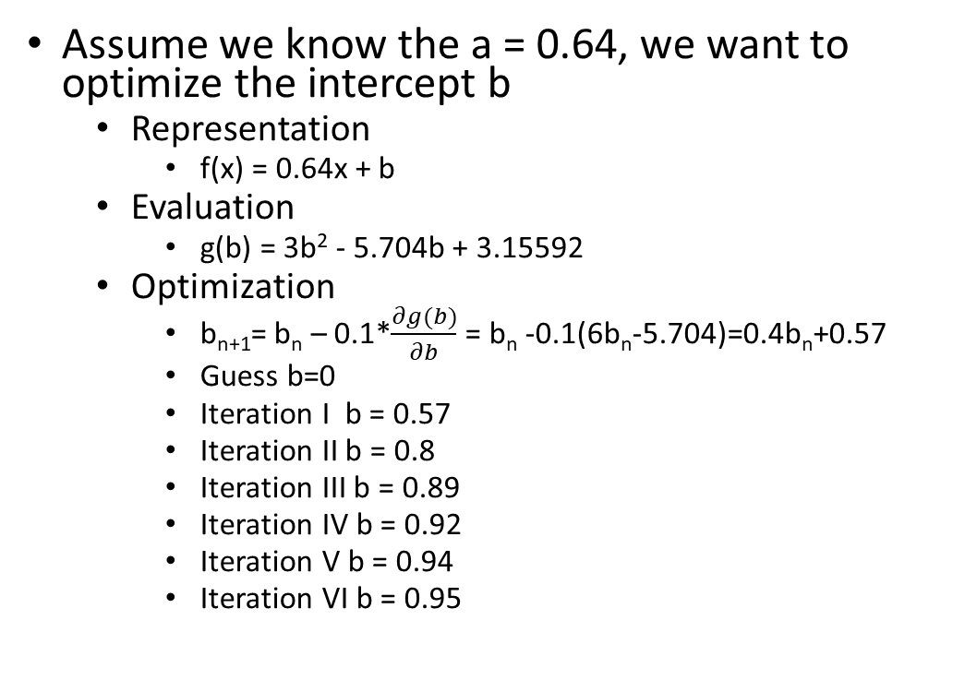
Example 1
Assume we know the a = 0.64, we want to optimize the intercept b
Representation
f(x) = 0.64x + b
Evaluation
g(b) = 3b² - 5.704b + 3.15592
Optimization
b_{n+1}= b_{n} – 0.1*$\frac{∂g(b)}{∂b}$ = b_{n} -0.1(6b_{n}-5.704)=0.4b_{n}+0.57
Guess b=0
Iteration I b = 0.57
Iteration II b = 0.8
Iteration III b = 0.89
Iteration IV b = 0.92
Iteration V b = 0.94
Iteration VI b = 0.95
C(2.9,3.2)
3
2
B(2.3,1.9)
A(0.5,1.4)
1
0
1
2
3

Slide 7
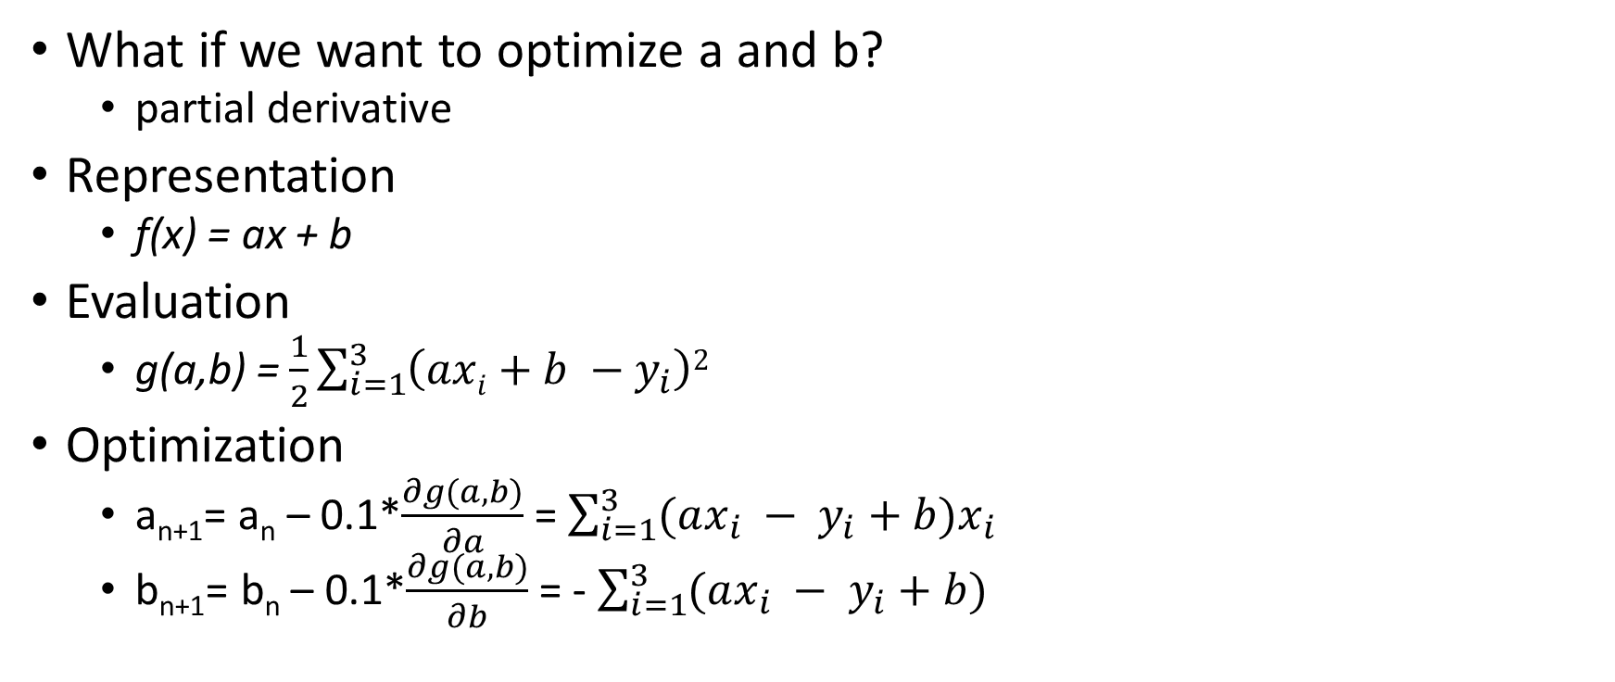
Example 2
What if we want to optimize a and b?
partial derivative
Representation
f(x) = ax + b
Evaluation
g(a,b) = $\frac{1}{2}\sum_{i=1}^{3}{\left(axi+b −y_{i}\right)2}$
Optimization
a_{n+1}= a_{n} – 0.1*$\frac{∂g(a,b)}{∂a}$ = $\sum_{i=1}^{3}{(ax_{i} − y_{i}+b)x_{i}}$
b_{n+1}= b_{n} – 0.1*$\frac{∂g(a,b)}{∂b}$ = - $\sum_{i=1}^{3}{(ax_{i} − y_{i}+b) }$
C(2.9,3.2)
3
2
B(2.3,1.9)
A(0.5,1.4)
1
0
1
2
3

Slide 8
Gradient Descent
Step 1: Take the derivative of the Loss Function for each parameter in it. In fancy Machine Learning Lingo, take the Gradient of the Loss Function.
Step 2: Pick random values for the parameters.
Step3: Plug the parameter values into the derivatives
Step 4: Calculate the Step Sizes: Step Size = Learning Rate * Slope
Step 5: Calculate the New Parameters:
New Parameter = Old Parameter –Step Size
Step 6: Go back to Step 3 and repeat until Step Size is very small, or you reach the Maximum Number of Steps.

Slide 9
Learning rate
What is a good value of the learning rate?
What happens if the learning rate is too large or too small?

Slide 10
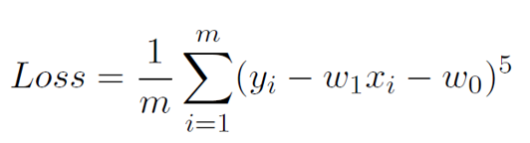
Exercise
Consider a linear regression problem y = w₁x + w₀, with a training set having m examples (x₁, y₁), …, (x_{m}, y_{m}). Suppose that we wish to minimize the mean fifth degree error (loss function) given by:
Provide the formulas to update parameters w₁ and w₀, given the learning rate is η

Slide 11
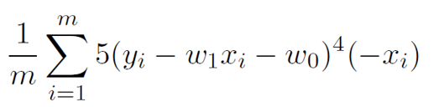
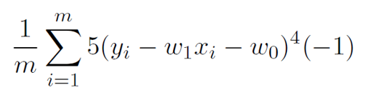
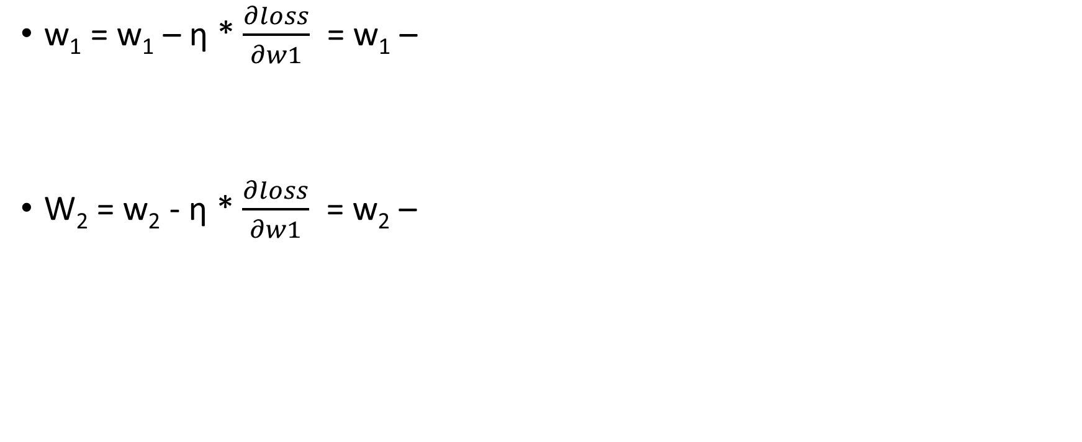
Answer
w₁ = w₁ – η * $\frac{∂loss}{∂w1}$ = w₁ –
W₂ = w₂ - η * $\frac{∂loss}{∂w1}$ = w₂ –

Slide 12
Linear Regression
Setting: x and f(x) are two real number
Linear Regression: assume they have the relationship f(x) = ax + b for two constant a, b.
Training data: (x₁, y₁), (x₂, y₂), …, (x_{n}, y_{n})
Loss: ERROR(a, b) = ∑(y_{i} – (ax_{i} + b))²

Slide 13
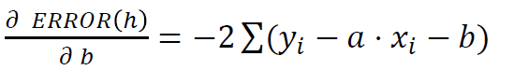
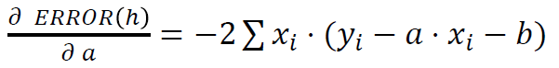
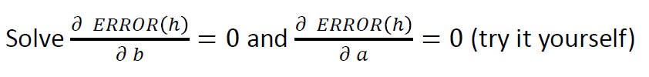
Linear Regression
Partial Derivatives

Slide 14
Example 1
Consider the following set of points:
(-2, -1), (1,1), (3,2)
Find the linear regression line for the given data points using least square loss function.

Slide 15
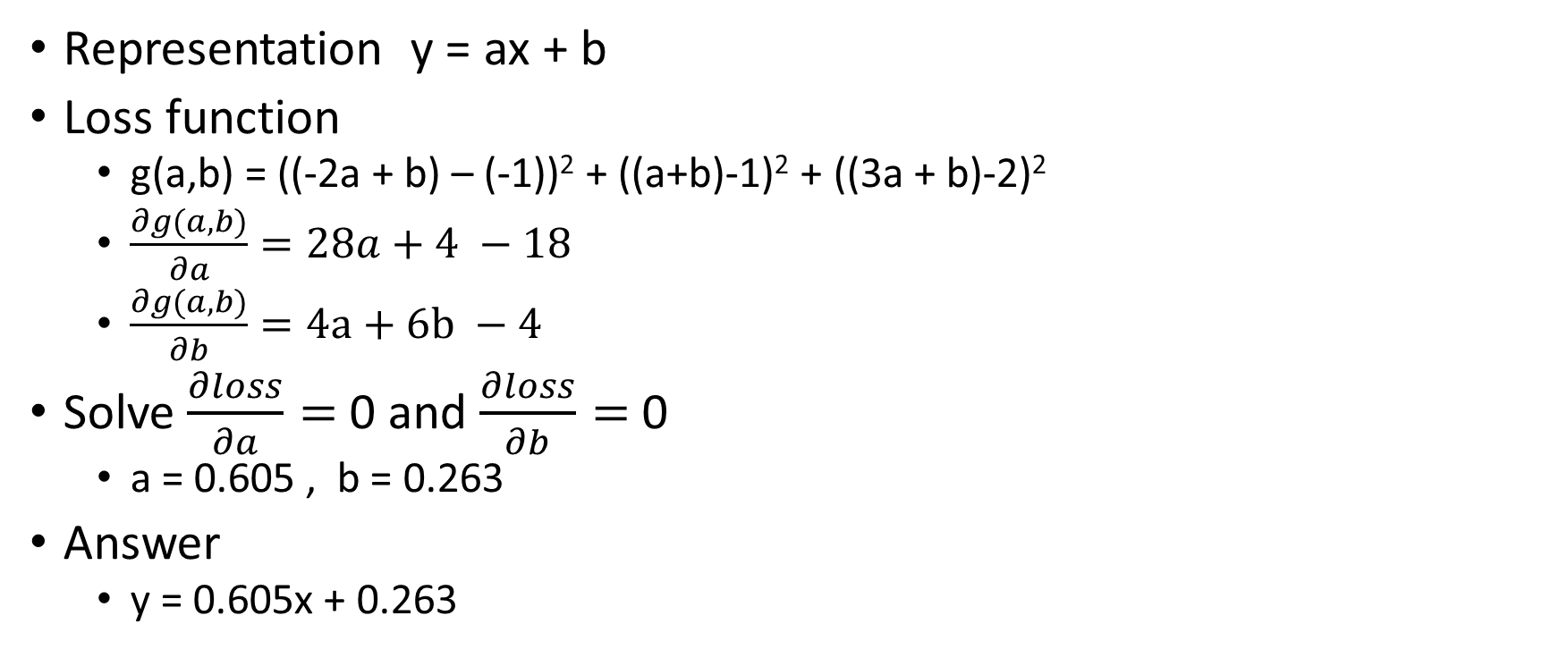
Answer
Representation y = ax + b
Loss function
g(a,b) = ((-2a + b) – (-1))² + ((a+b)-1)² + ((3a + b)-2)²
$\frac{∂g(a,b)}{∂a}=28a+4 −18$
$\frac{∂g(a,b)}{∂b}=4a+6b −4$
Solve $\frac{∂loss}{∂a}=$ 0 and $\frac{∂loss}{∂b}=$ 0
a = 0.605 , b = 0.263
Answer
y = 0.605x + 0.263

Slide 16
Linear Regression Multivariable

Slide 17
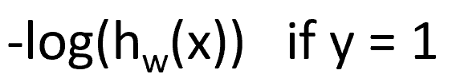
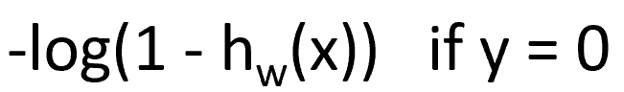
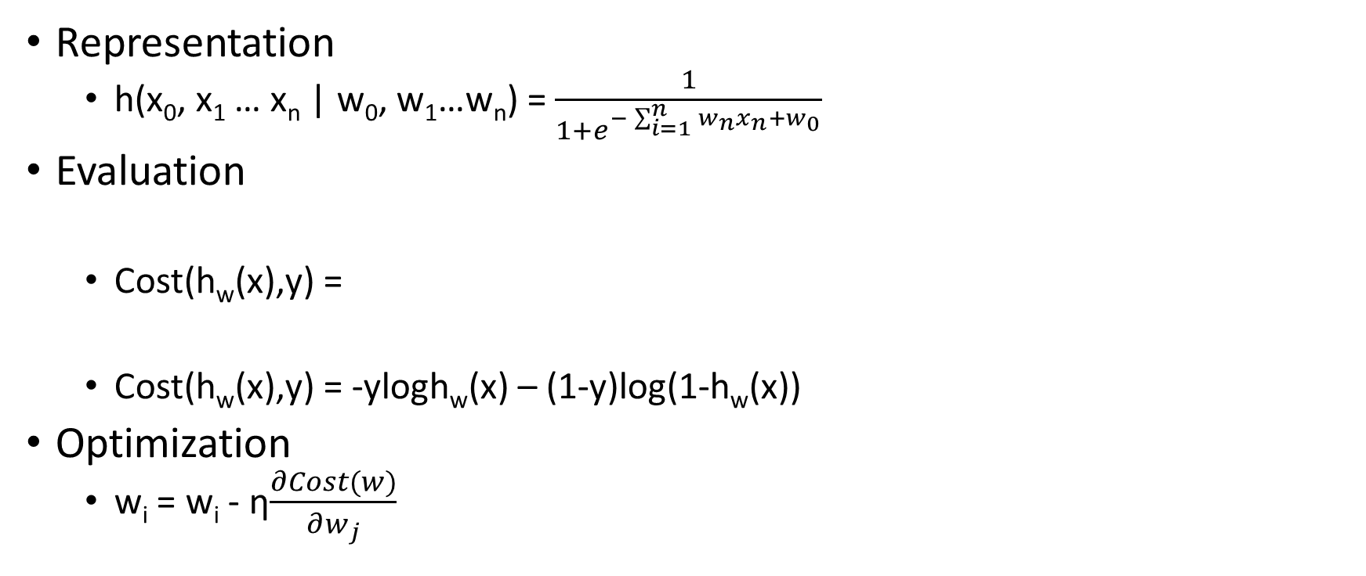
Logistic Regression
Representation
h(x₀, x₁ … x_{n} | w₀, w₁…w_{n}) = $\frac{1}{1+e^{−\sum_{i=1}^{n}{w_{n}x_{n}+}w_{0}}}$
Evaluation
Cost(h_{w}(x),y) =
Cost(h_{w}(x),y) = -ylogh_{w}(x) – (1-y)log(1-h_{w}(x))
Optimization
w_{i} = w_{i} - η$\frac{∂Cost(w)}{∂w_{j}}$

Slide 18
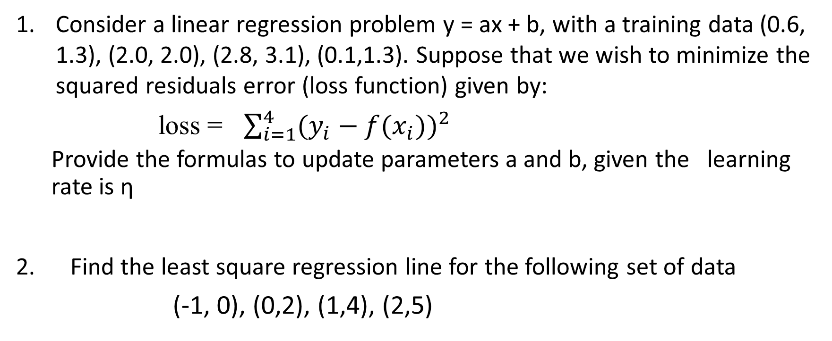
Quiz
Consider a linear regression problem y = ax + b, with a training data (0.6, 1.3), (2.0, 2.0), (2.8, 3.1), (0.1,1.3). Suppose that we wish to minimize the squared residuals error (loss function) given by:
loss = $\sum_{i=1}^{4}{{(y_{i}−f(x_{i}))}^{2}}$
Provide the formulas to update parameters a and b, given the learning rate is η
2. Find the least square regression line for the following set of data
(-1, 0), (0,2), (1,4), (2,5)

Slide 19
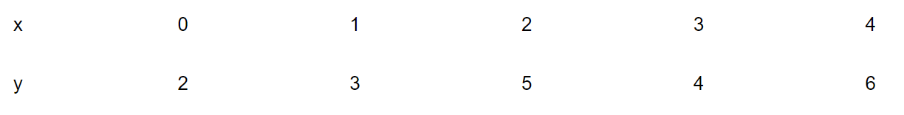
Homework
The values of x and their corresponding values of y are shown in the table below
A) Find the least square regression line y = ax + b
B) Estimate the value of y when x = 10

